Slide 1
Eigenvalues 2: Shifted QR and Least Squares
AMSC/CMSC 460
Dr. Christopher Moakler

Slide 2
Review from last lecture
There is no good direct way of finding the eigenvalues of a matrix.
The typical method of using the characteristic polynomial is not suitable for the large matrices we may be interested in.
We looked at an example of a diagonal matrix with the values of 1 to 20 on the diagonal.
It has coefficients on the order of 20! Which is too large to store in IEEE double precision.
We needed a better way to find eigenvalues, so we turned to iterative methods.
The first was the Power Iteration Method where we multiply the matrix A by an arbitrary vector.
$$x_{i+1}=Ax_{i}$$

Slide 3
Review from last lecture cntd
If repeated enough times, we would converge to the eigenvector with the largest eigenvalue.
This is sometimes called the dominant eigenvalue.
The transformation of the matrix A tends to move a vector in this direction.
It dominates because the eigenvalue is how much the matrix scales a vector.
This procedure requires $O(n^{2})$ Flops at every iteration and only finds one eigenvalue and eigenvector.
We can instead use Inverse Power Iteration which multiplies by the inverse of the matrix A.
$$x_{i+1}=A^{−1}x_{i}$$

Slide 4
Review from last lecture cntd
We typically rewrite this as,
$$Ax_{i+1}=x_{i}$$
and solve it using Gaussian Elimination.
The IPI method finds the smallest eigenvalue and the associated eigenvector.
We also looked at the Shifted Inverse Power Iteration method where we shift the matrix to $A −sI$ and find the eigenvalue of this.
$$(A−sI)x_{i+1}=x_{i}$$
This finds the eigenvalue closest to s.
If we have a good guess for s, we can get very quick convergence.
We don’t use this method with Power Iteration because that would find the eigenvalue furthest from s which is much less useful.

Slide 5
Review from last lecture cntd
One further modification was the Rayleigh Quotient Algorithm which has very fast convergence for single eigenvalues.
This allows us to find more than just the smallest and largest eigenvalues.
We can use this idea to find ALL eigenvalues at once.
One approach is the Unshifted QR Algorithm.
The basic approach here is to convert A into a similar matrix that is upper triangular so we can read the eigenvalues off of it.
This works for symmetric matrices with no repeated eigenvalues.

Slide 6
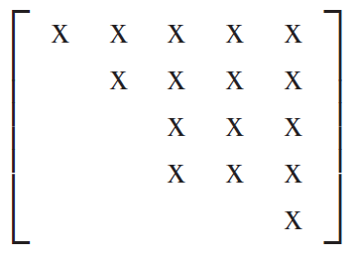
Real Schur Form
To continue our study of matrix eigenvalues, we probably want a way to find the eigenvalues of a nonsymmetric matrix.
To do this, we’ll need to know some things about the “real Schur form”.
A matrix is in a real Schur form if it upper triangular except for some instances of 2 x 2 matrices on the diagonal.
Any square matrix with real elements is similar to a matrix
that is in the real Schur form.
$A=Q^{T}TQ$
Here T is a real Schur matrix and Q is orthogonal.
Sauer

Slide 7
Real Schur Form cont
The eigenvalues of a real Schur form matrix are very easy to compute.
The 1 x 1 matrices on the diagonal are eigenvalues and the eigenvalues of the 2 x 2 submatrices are eigenvalues.
Since these are eigenvalues of the matrix T, they are also eigenvalues of the matrix A since they are similar.
The full QR algorithm moves the matrix A towards its real Schur form using similarity transformations which we will use to find its eigenvalues.
We’ll do this in two steps.

Slide 8
Shifted QR Algorithm
First, we shift the matrix and perform the QR factorization.
$$A_{0}−sI=Q_{1}R_{1}$$
We then form
$$A_{1}=R_{1}Q_{1}+sI$$
It’s important to see that
$A_{1}=Q_{1}^{T}Q_{1}R_{1}Q_{1}+sI$
$A_{1}=Q_{1}^{T}\left(A_{0}−sI\right)Q_{1}+sI$
$A_{1}=Q_{1}^{T}A_{0}Q_{1}−sI+sI$
$$A_{1}=Q_{1}^{T}A_{0}Q_{1}$$
Thus, $A_{1}$ is similar to $A_{0}$ and has the same eigenvalues.

Slide 9
Shifted QR Algorithm
What do we choose for the shift?
We will choose the value of the bottom right element to be our shift at every iteration.
This will allow us to home in on one eigenvalue and, once we have reached convergence, we will “deflate” the matrix and start over.
What do I mean by deflate?
We will remove the bottom row and rightmost column and reduce the size of the matrix from $n × n$ to $(n−1) ×\left(n−1\right)$.
So, at every iteration, we check the elements on the last row.
If all elements are “small” except for the element on the diagonal, we remove that row and column and store the eigenvalue.

Slide 10
Shifted QR Algorithm algorithm (draft)
while n > 1
while max(A(n,1:n-1))>tol
s = A(n,n); %value of shift s
[Q,R] = $QR_Decomposition$(A-sI); %Decompose the shifted matrix
A = R*Q+sI; %Move it towards real schur form
end
lam(n) = A(n,n); %We have found one eigenvalue
n = n -1 %decrement n
A = A(1:n,1:n) %deflate
end
lam(1) = A(1,1) %Last eigenvalue is the remaining element.

Slide 11
Improved Shifted QR Algorithm
That algorithm works fine if we can put the matrix into a fully upper triangular form.
However, sometimes the matrix contains $2×2$ submatrices on the diagonal.
We need a way to account for this possibility in the algorithm.
This is simple enough.

Slide 12
Improved Shifted QR Algorithm algorithm
while n > 1
nstep = 0;
while max(A(n,1:n-1))>tol && nstep < nstep_max
nstep = nstep + 1
s = A(n,n); % value of shift s
[Q,R] = $QR_Decomposition$(A-sI); % Decompose the shifted matrix
A = R*Q+sI; % Move it towards upper schur form
end
if nstep < nstep_max % We have a 1x1 submatrix
lam(n) = A(n,n); % We have found one eigenvalue
n = n -1 % decrement n
A = A(1:n,1:n) % deflate
else %We have a 2x2 submatrix
discriminant = (A(n-1,n-1)-A(n,n))^2 + 4*A(n,n-1)*A(n-1,n)
lam(n) = (A(n-1,n-1)-A(n,n) + sqrt(discriminant))/2
lam(n-1) = (A(n-1,n-1)-A(n,n) - sqrt(discriminant))/2
n = n-2
A=A(1:n,1:n)
end
end
if n>0
lam(1) = A(1,1) % Last eigenvalue is the remaining element. end

Slide 13
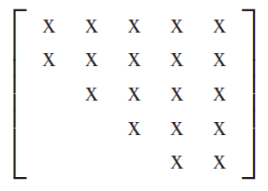
Upper Hessenberg Form
The Improved Shifted QR Algorithm will not be able to move all matrices into a real Schur form.
This can occur when the matrix has repeated complex eigenvalues.
To find these, we need to replace matrix with an Upper Hessenberg matrix.
An Upper Hessenberg matrix is one where $a_{ij}=0 ∀i,j:j>i+1$
To do this, we will need Householder reflectors.
Sauer

Slide 14
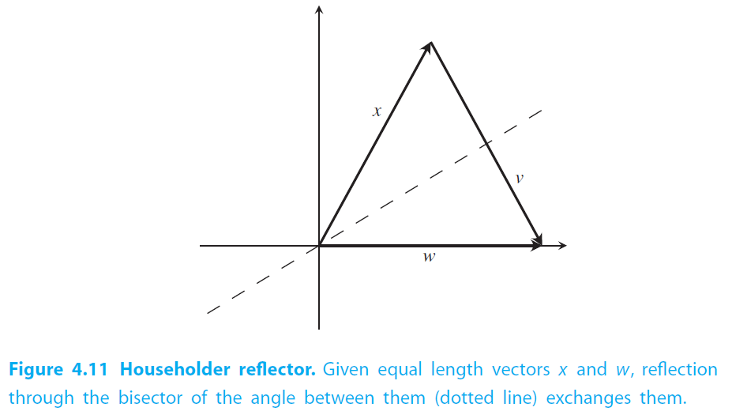
Householder Reflectors
A Householder Reflector is an orthogonal matrix that reflects all $n$-vectors through a $n−1$ dimensional hyperplane.
The length of the vector remains unchanged which makes them useful for manipulating vectors.
With a Householder reflector we can take an
arbitrary vector x to a vector w with the same
length using the equation,
$$Hx=w$$
We can do this easily using a projection matrix
$P= \frac{vv^{T}}{v^{T}v}$.
It’s easy to see that the Householder reflector is thus
$$H=I −2P$$
Sauer

Slide 15
Householder Reflectors cont
In general, if we have two vectors with the same magnitude ${\left|\left|x\right|\right|}_{2}={\left|\left|w\right|\right|}_{2}$and we want to find the Householder reflector that takes x to w
Form $v =w−x$
$H=I −2\frac{vv^{T}}{v^{T}v}\text{.}$
$Hx=w$
Ex. Find the Householder reflector that takes $x=[3 4]$ to $w=[5 0]$
$$v=\left[\begin{matrix}5 \\ 0\end{matrix}\right]−\left[\begin{matrix}3 \\ 4\end{matrix}\right]=\left[\begin{matrix}2 \\ −4\end{matrix}\right]$$
$$P= \frac{1}{20}\left[\begin{matrix}4 & −8 \\ −8 & 16\end{matrix}\right]=\left[\begin{matrix}0.2 & −0.4 \\ −0.4 & 0.8\end{matrix}\right]$$
$$H=I−2P=\left[\begin{matrix}0.6 & 0.8 \\ 0.8 & −0.6\end{matrix}\right]$$

Slide 16
Upper Hessenberg using Householder Reflectors
We will now use Householders reflectors to find a similar matrix that is Upper Hessenberg
$$A=Q^{T}HQ$$
We begin by defining $x$ to be the vector containing all but the first element of the first column of A.
We then form $\hat{H_{1}}$ to be the Householder reflection that takes $x$ to the vector $\left[{\left|\left|x\right|\right|}_{2},0,0…,0\right]$
$H_{1}$ is then the Identity matrix with $\hat{H_{1}}$ inserted into the bottom right corner.
Sauer

Slide 17
Upper Hessenberg using Householder reflectors cntd
We need to insert the right-hand orthogonal matrix as well
We are making progress! We have the first column completed.
We then continue with this procedure now taking $x$ to be the $n−2$ vector consisting of all but the first two elements of the second column.
Sauer
Sauer

Slide 18
Upper Hessenberg using Householder Reflectors cntd
We continue this procedure until we run out of steps.
In general, to put an $n×n$ matrix into Upper Hessenberg form requires $n−2$ steps.
We now have a matrix $H_{i}H_{i−1}…H_{1}AH_{1}^{T}…H_{i−1}^{T}H_{i}^{T}=QAQ^{T}$ that is similar to $A$.
This matrix has the same eigenvalues as the original matrix A.
Since it is in Upper Hessenberg form, we can apply our previous Improved Shifted QR Algorithm to find the eigenvalues of the matrix.

Slide 19
Upper Hessenberg Form Example
Let’s put the matrix
$$A=\left[\begin{matrix}2 & 1 & 0 \\ 3 & 5 & −5 \\ 4 & 0 & 0\end{matrix}\right]$$
into Upper Hessenberg Form.
We take $x=\left[\begin{matrix}3 \\ 4\end{matrix}\right]$
We found the necessary Householder reflector earlier,
$$\left[\begin{matrix}0.6 & 0.8 \\ 0.8 & −0.6\end{matrix}\right]\left[\begin{matrix}3 \\ 4\end{matrix}\right]=\left[\begin{matrix}5 \\ 0\end{matrix}\right]$$
So, we now have,
$$H_{1}A=\left[\begin{matrix}1 & 0 & 0 \\ 0 & 0.6 & 0.8 \\ 0 & 0.8 & −0.6\end{matrix}\right]\left[\begin{matrix}2 & 1 & 0 \\ 3 & 5 & −5 \\ 4 & 0 & 0\end{matrix}\right]=\left[\begin{matrix}2 & 1 & 0 \\ 5 & 3 & −3 \\ 0 & 4 & −4\end{matrix}\right]$$

Slide 20
Upper Hessenberg Form Example cntd
Finally, we form,
$$H_{1}AH_{1}=\left[\begin{matrix}2 & 1 & 0 \\ 5 & 3 & −3 \\ 0 & 4 & −4\end{matrix}\right]\left[\begin{matrix}1 & 0 & 0 \\ 0 & 0.6 & 0.8 \\ 0 & 0.8 & −0.6\end{matrix}\right]=\left[\begin{matrix}2 & 0.6 & 0.8 \\ 5 & −0.6 & 4.2 \\ 0 & −0.8 & 5.6\end{matrix}\right]$$
What’s next?
This is in Upper Hessenberg Form so we’re done with that part.
What do we do now with the matrix?

Slide 21
Upper Hessenberg algorithm
for i = 1:n-2
x = A(i+1:n,i);
v(1:n-i,i) = -sign(x(1))*norm(x)*eye(n-I,1)-x;
v(1:n-i,i) = v(1:n-i,i)/norm(v(1:n-i,i));
A(i+1:n,i:n) = A(i+1:n,i:n) -2*v(1:n-i,i)*v(1:n-i,i)’*A(i+1:n,i:n);
A(1:n,i+1:n) = A(1:n,i+1:n) -2*A( : ,i+1:n)*v(1:n-i,i)*v(1:n-i,i)’;
end

Slide 22
Upper Hessenberg and QR algorithm
Sometimes the Upper Hessenberg algorithm puts the matrix into the real Schur form right away.
Sometimes we need to apply the Improved Shifted QR algorithm to put the matrix into a real Schur form.
Either way, we can easily compute the eigenvalues of any arbitrary matrix using this algorithm.
This is the method that Matlab’s “eig” function uses to compute eigenvalues.
Unless the matrices are symmetric where it instead uses Cholesky decomposition.

Slide 23
Least Squares

Slide 24
Inconsistent Systems of Equations
We previously looked at systems of the form
$$Ax=b$$
The matrices were all full rank and the systems had unique solutions.
That is, the systems of equations the matrix equation represented had as many unknowns as it does independent equations and they were all consistent.
The matrix A is square and invertible
What if we have equations that have no solution?
The system is said to be “inconsistent”.

Slide 25
Inconsistent system example
Take for example the system
$$x_{1}+x_{2}=2$$
$$x_{1}−x_{2}=1$$
$$x_{1}+x_{2}=3$$
This system has no solution!
Any solution that satisfies equation 1 can not satisfy equation 3!
Why do we care about systems that have no solution?
Well, there are some good reasons why we might have an inconsistent system
Our coefficients are slightly off leading to an inconsistent set of equations.
We have more equations than unknowns

Slide 26
Why do we care?
We can’t apply Gaussian elimination or any of the other methods we proposed previously.
They won’t converge or the algorithm will halt.
We often want to solve these systems of equations even if there is no solution though.
Scientists are annoying like that.
They want answers when literally none can possibly exist.
So, what do we do? We cut our losses.
We try to find the vector $x$ that comes closest to being correct.
What does it mean to be closest to the correct answer?

Slide 27
Method of Least Squares
If we define closeness to mean closest in Euclidean Distance, we have a straightforward algorithm to solve for the closest answer which we call the least squares solution.
This was first published by Legendre in 1805 who used it to analyze data about the shape of the Earth.
It very quickly became a standard tool in multiple fields of science.
In 1809 Gauss published a result using least squares to calculate the orbits of celestial objects.
He claimed to have figured out least squares first in 1795.
Disputes about priority are the best kinds of flame war.

Slide 28
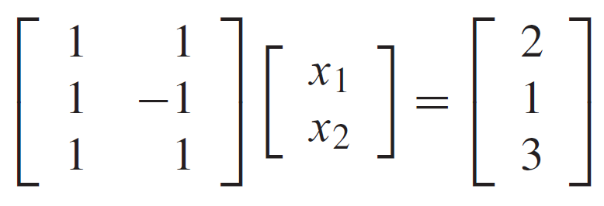
Normal Equations
Take an inconsistent system of equations
We can think of this as linear combinations of the column vectors
These sweep out a plane $Ax$
Our RHS vector $b$ can not lie in this plane otherwise we would have an exact solution.
The best we can get is a solution $\overline{x}$ whose residual is perpendicular to the plane $Ax$
Sauer
Sauer

Slide 29
Normal Equations graphically
Sauer

Slide 30
Normal Equations contd
The condition that the residual is perpendicular to the plane $Ax$is simply,
$${\left(Ax\right)}^{T}\left(b−A\overline{x}\right)=0 ∀x$$
We can rewrite this as
$$x^{T}A^{T}\left(b−A\overline{x}\right)=0 ∀x$$
The only way for the vector $A^{T}\left(b−A\overline{x}\right)$ to be perpendicular to every vector $x$ is if that vector is the zero vector, i.e.,
$$A^{T}\left(b−A\overline{x}\right)=0$$
This can be rewritten as
$$A^{T}A\overline{x}=A^{T}b$$
Solving this gives the least squares solution $\overline{x}$.

Slide 31
Summary
We first looked at extending our Unshifted QR algorithm to the shifted QR algorithm.
We did this to replace the matrix A with a transformed matrix that had the same eigenvalues but is in the real Schur form.
This let us easily compute the eigenvalues.
That only works for some matrices so we had to extend our method to work for any arbitrary method.
We did this by first putting a matrix into Upper Hessenberg form by using Householder Rotators.
After putting a matrix into an Upper Hessenberg form, we can apply the Improved Shifted QR Algorithm to find the eigenvalues.

Slide 32
Summary part 2
We switched gears to looking at inconsistent systems of equations
This happens when our system has no solution which often occurs if we have more equations than unknowns.
We can not hope to find a solution for these systems because none exist.
We can instead try to find an equation that is in a sense “closest” to the “true” answer.
We looked at one way of doing this using Normal Equations

